Slide 1
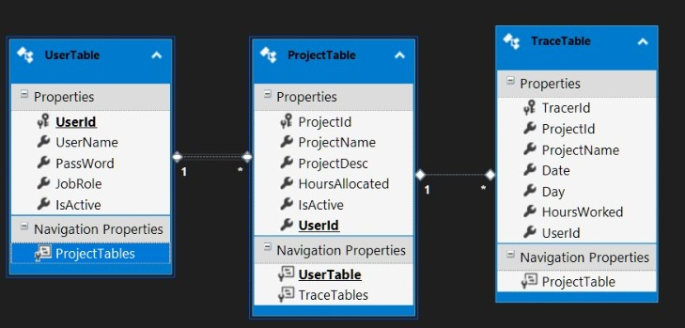

Entity Diagram
One to Many
One to Many

Slide 2
Home Page
Log in
Register
User Dashboard
Data Base
User tries to Log in
If User id and Password Matches
If User id & Password doesn’t matches
If User id and Password are good enough to register and stored in Database
User tries to Register
After User registration it directs to the dashboard
User Start to Add a new project and stores in database
User Start to Add a existing project’s Details and stores in database
If user needs to view their data , the data is fetched from database
User hits the Log out Button

Slide 3
Creation Controller
Authentication Controller
Dashboard Controller
Report Controller
Creation Controller
User Id
User Name
User Password
Job Role
IsActive
User Id
User Password
AddProject()
AddWork()
LogOut()
Generates Report for User View
Register()
LogIn()
Delete()
Service Register()
Service Login()
Service AddProject()
Service AddWork()
Service Register()
User Id
User Name
User Password
Job Role
IsActive
User Id
User Password
Project Id
Project Name
Hours Allocated
Project Name
Work Description
Date
Day
Hours Worked
Project Name
Work Description
Date
Day
Hours Worked
Hours Allocated
<<Entity Bean>> Register
<<Entity Bean>> Dashboard
<<Entity Bean>> Report
User Id
User Name
User Password
Job Role
IsActive
Project Id
Project Name
Work Description
Date
Day
Hours Allocates
Hours Worked
Project Id
Project Name
Work Description
Date
Day
Hours Worked
Hours Allocated

